Slide 1

Language and the Brain
Richard Wise
Division of Brain Sciences Imperial College

Slide 2
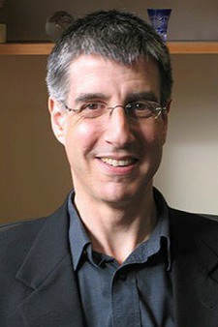
Daniel Wolpert
“We have a brain for one reason and one reason only – that’s to produce adaptable and complex movements. Movement is the only way we have
of affecting the world around us….. And therefore it’s important to remember when you are studying memory, cognition, sensory processing, they’re there for a reason, and that reason is action.”

Slide 3


Slide 4

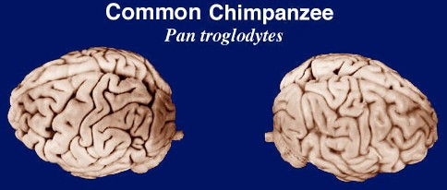

Slide 5
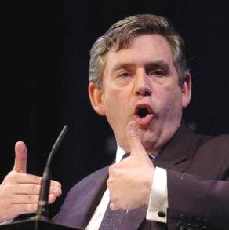
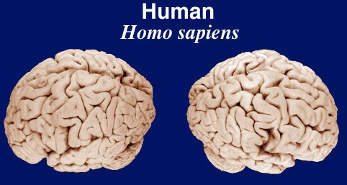

Slide 6

Breathing during speech
Lung volume
External intercostals
Internal intercostals
Subglottal pressure

Slide 7
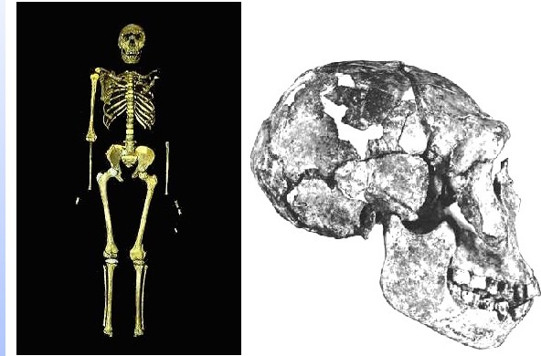
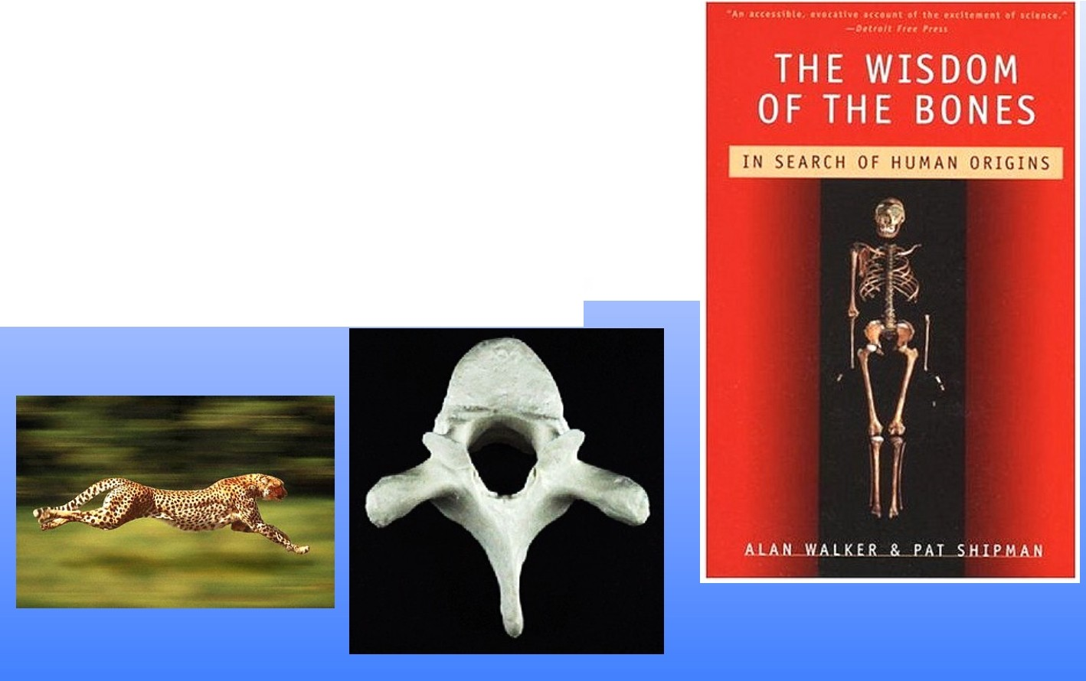
'K'1f'M-W'T 15000 ('Tu' rtana 'Boy)
'K'1f'M-W'T 15000, "'Turfana 'Boy",'J[omo erectus (or 'lfomo er8asmr)

Slide 8

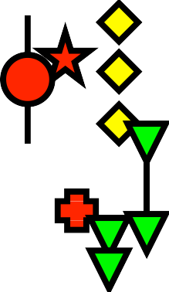

MacLarnon AM and Hewitt GP (1999) American Journal of Physical Anthropology 109:341-63
2.5
Log (10) minimum thoracic c.s.a. (mm²)
2.0
1.5
4.0
4.5
Log (10) body weight (g)
Homo ergaster
5.0
Extant humans ± 2 SD Early modern human Neantherdals
A. africanus
A. afarensis
Apes with range for sp.

Slide 9

What is special about the human brain?
Richard Passingham
“Chapter 4 reviewed the evidence that the ability to move the fingers independently depended on direct projections on to the motor neurons in the spinal cord.”
“Simonyan and Jurgens (2003) have traced the descending projections from the cortical larynx area in the monkey.
…..there are no direct projections to either the hypoglossal nucleus (tongue) or to the nucleus ambiguus (larynx).”
“Yet there are direct projections from the cortex to those nuclei in the human brain (Kuypers, 1958).

Slide 10
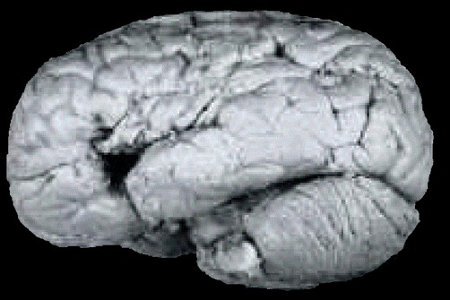
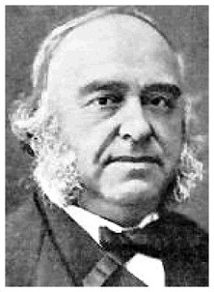
Paul Broca 1861 - patient Leborgne, or ‘Tan’
Both localised and lateralised the faculty of articulate language – a domain- specific function

Slide 11
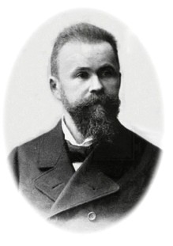

Brain and language
Broca’s area
Wernicke’s area
Speech out
Speech in

Slide 12
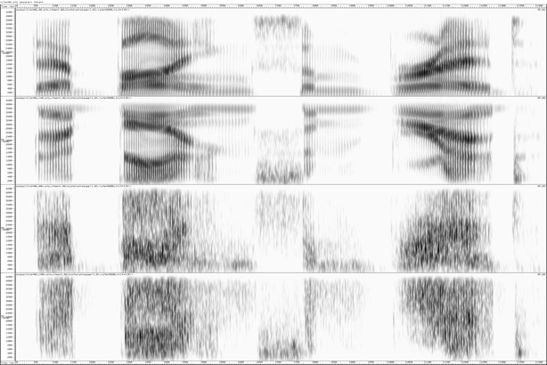
“they’re buying some bread”
F
time
F1
F2
F3
Vocal tract resonances (formants) - articulators
Source - larynx

Slide 13
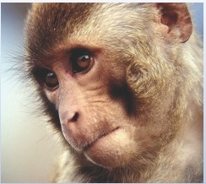
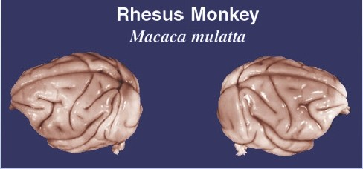
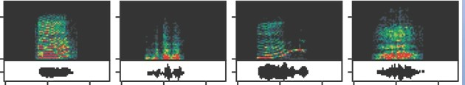

coo
grunt
harmonic arch
bark
tonal scream
growl
arch scream
,. 10
-
:c
-"

Slide 14
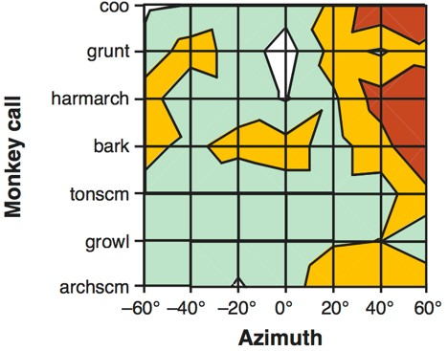
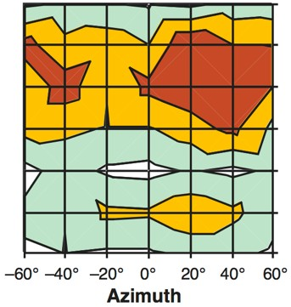
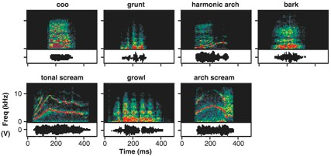
Tian B et al. (2001) Functional specialization in rhesus monkey auditory cortex. Science 292:290-3
Monkey call
Azimuth

Slide 15
Dual routes
Tpt
CM
CL
‘Where’
Core
insula
‘What’

Slide 16


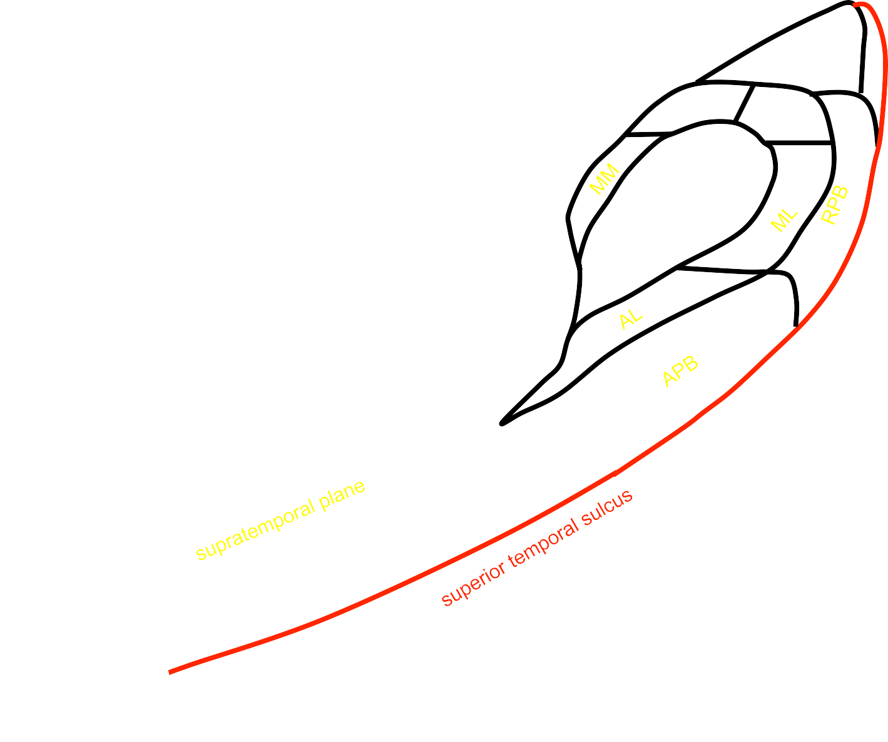

Dual routes
Tpt
CM
CL
‘How’
Core
insula
‘What’

Slide 17

Brain and language
Broca’s area
Wernicke’s area
Speech out
Speech in

Slide 18
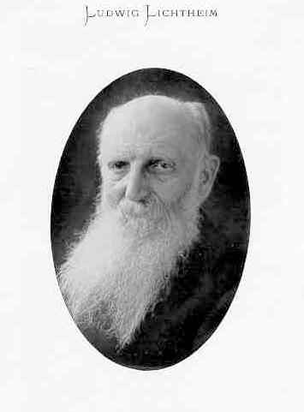
Brain and language
‘Concept’ area
Broca’s area
Wernicke’s area
Speech out
Speech in

Slide 19
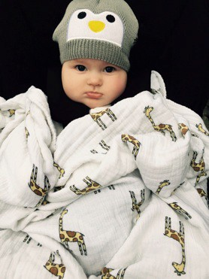
Brain and language
‘Concept’ area
area Wer
Broca’s
nicke’s area
Speech out
Speech in

Slide 20
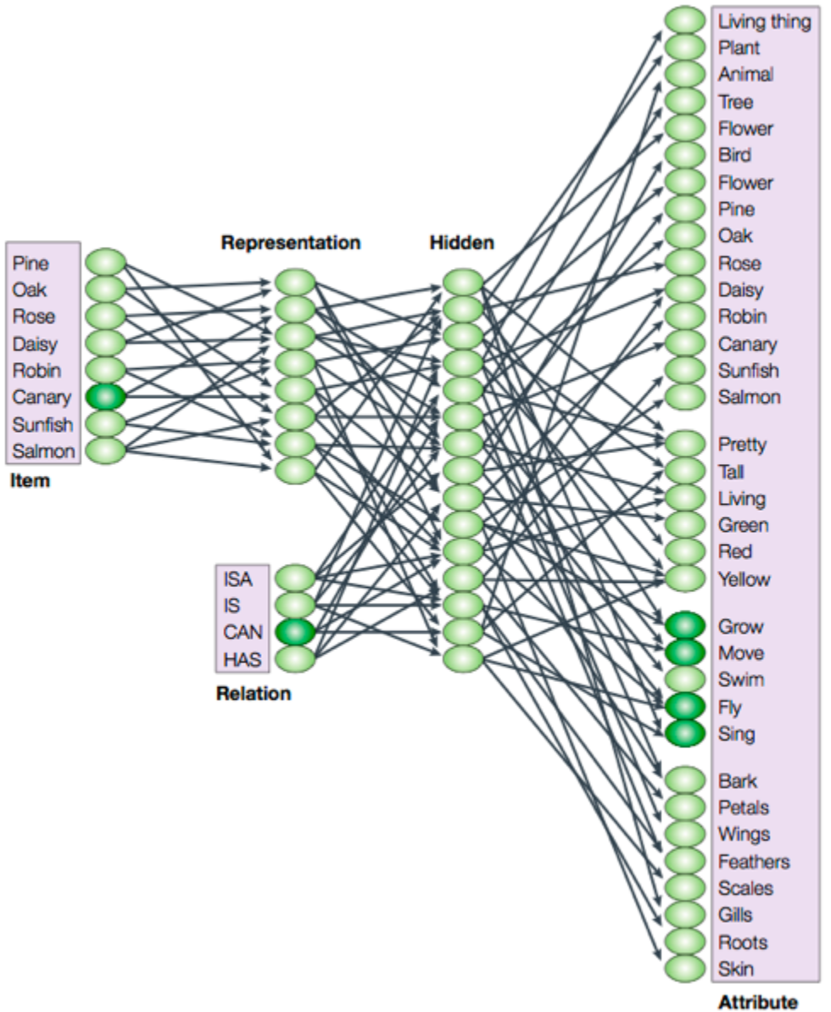
McLelland JL, Rogers TR. The parallel distributed processing approach to semanMc cogniMon. Nature Neurosci Rev (2003) 4:310-­‐22

Slide 21
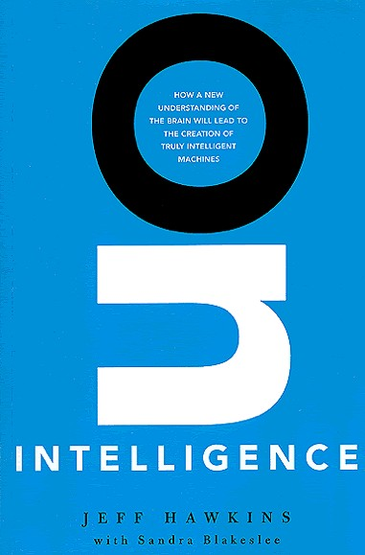
Jeﬀ Hawkins “Why can’t a computer be more like a brain?”

Slide 22
I saw a puppy in the window. I want it.

Slide 23
Why do you want a window?

Slide 24
I want a puppy.

Slide 25
But it’s embedded in glass.

Slide 26
No, behind the window. Of the pet shop.

Slide 27
According to my database, a puppy: pees on furniture
costs a lot to feed
Which of these attributes makes you want it?

Slide 28
I’m going to switch you off now.

Slide 29
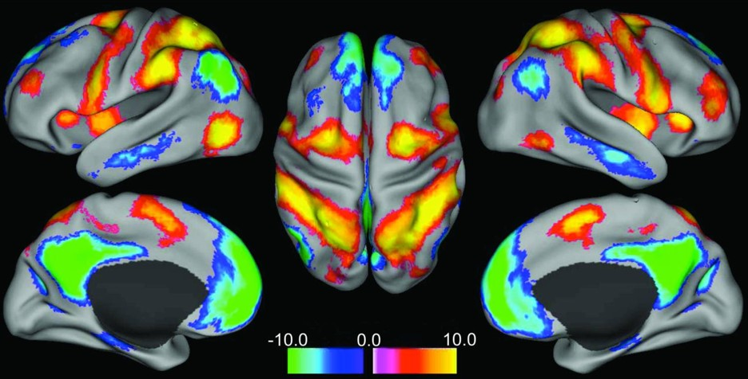
Fox MD et al. (2005) The human brain is intrinsically organized into dynamic, anticorrelated functional networks. Proceedings of the National Academy of Science USA 102: 9673-9678.

Slide 30
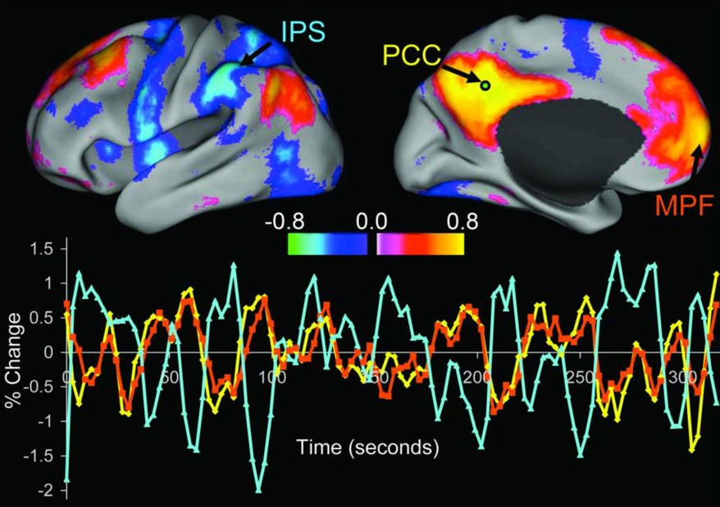
Fox MD et al. (2005) The human brain is intrinsically organized into dynamic, anticorrelated functional networks. Proceedings of the National Academy of Science USA 102: 9673-9678.

Slide 31

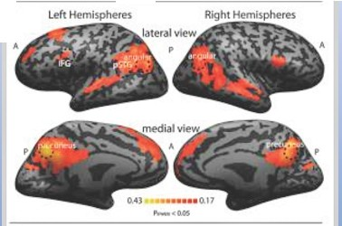


Modality innrlanc•
A
, left pSTG
:
@W
r-<J.47
· ..
),
,.
"'
""
Ml$
Precuneus
•
..
,,
•
.., """"" "''
Spoken Written
B
Beha\•ioral/Cognitive
Selective and Invariant Neural Responses to Spoken and Written Narratives
Mor Rtgev.•J: Otristopher J.Honey.¹.1ErnSimony.•J: and Uri Hasson ¹.t
'DcJNrtmml ol Psythologr and:Pri.nuton Neu/'Olatni:e lnstih1tt,Princeton University, Pri.nuton., N,:w Jcnty 08540
c
.
left IFG
•left pSTG
precuneus
•
Lt UI
---
..
•
left angular 9yrus
right angular gyrus •v.1dllnSpoun nam,uw
•
•..
•Yndwn""°ltwn n.,rr,thv
•8et'M!ffl Spoken and
W'rll\tf'l l),l(l,...
awit111n ft'ltrH spff(tl
_.. Yl'lthln $Clamtlt.dltnlft
•
._._.._._-

Slide 32
Spotlights
Trends in Cognitive Sciences March 2014, Vol. 18, No. 3
Default mode network: the seat of literary creativity?
Richard J.S.Wise¹ and Rodrigo M.Braga¹ ²
•
The recent result addresses the literary as opposed to simply the lingual brain. There is a longstanding and often ill-tempered debate about whether Shakespeare actually wrote, singly or as a co-author, the 37 plays attributed to him. It is argued that only a well-travelled Tudor aristo­ crat, versed in the ways of courtly love, would have had the experiences to write the histories, tragedies, and romantic comedies attributed to Shakespeare. Now we can speculate that some background reading and curiosity about the motivations of others, coupled with a spectacularly well­ connected DMN, made the bard immortal despite his humble origins. And we know that the DMN is as active in narrative production as it is in comprehension [10].

Slide 33
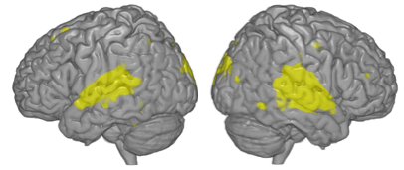
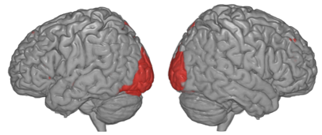
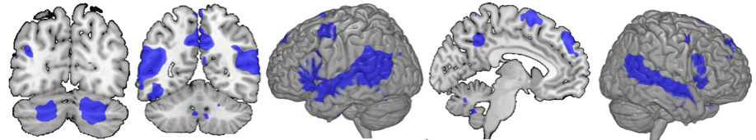
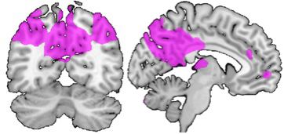
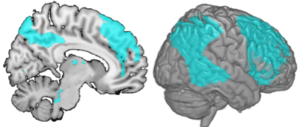
Reading
Listening
Intelligibility – acMvated systems
Intelligibility – deacMvated systems

