Slide 1
Broadening the reach of research into rare disease
James Thaventhiran
Notes:
Thank you for giving me the opportunity to talk to you this afternoon. I am based in the MRC Toxicology Unit– and my research

Slide 2
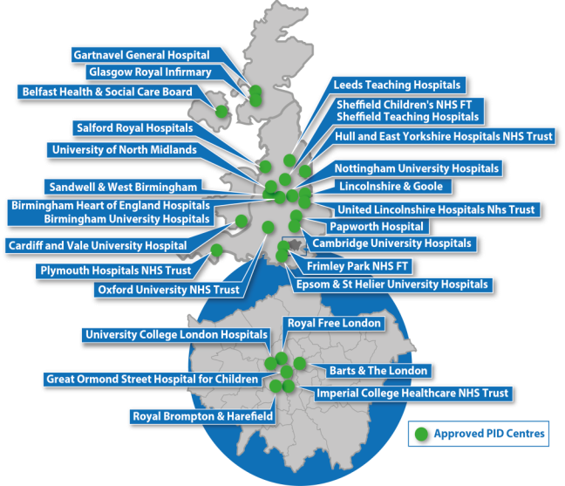
Inborn Errors of Immunity (IEI): A human model for pharmacological immune targetting
Inborn Errors of Immunity
NIHR Bioresource whole genome sequencing (WGS) PID Study
-Rare condition of heterogeneous aetiology
-Inherited susceptibility to infection
-Over 300 monogenic causal
genes identified
-Identified genes are in pathways targeted by drugs
2120 subjects recruited
= recruited 1/2 national cohort
1435 subject WGS data analysed
140 diagnostic reports issued
Partial penetrance is common
Phenotypic heterogeneity is common
29 UK recruiting centres
74 clinical collaborators
Research Results
IVNS1ABP haploinsuficiency
1st Description of WGS identifying non-coding mutation PID ARPC1B
2 novel GWAS susceptibility loci identified: Eomesodermin, IKZF1
3 novel monogenic IEI identified: SOCS1/PTPN2/ IVNS1 ABP
Broadening the impact of rare-disease research.
(Thaventhiran et al, Nature, 2020)
Notes:
So a brief introduction. Clinical Immunologists look after patients with primary immunodeficiency. This is a catch all term that describes severe infection susceptibility secondary to a primary defect within the immune system. With the use of exome sequencing the numbers of different monogenic causes has exponentially increased over the last 10 years. Many of the dysfunctional genes identified are in pathways targetted by drugs.
At the beginning of 2018 I was completing a research placement in which I had co-led the the establishement of the largest world-wide cohort study using whole-genome sequencing of primary immunodeficiency world-wide. We have recruited one half of the national cohort with this rare-condition, whole-genome sequenced one third and provided diagnositc reports in roughly 10%.
One of the unique characteristics of illness caused by specific immune gene dysregulation was the frequent partial penetracnce we observed and the phenotypic heterogeneity seen. For instance in patient with NFKB1 haploinsufficiency I have individual members of the same pedigree unaffected, with end stage liver failure and with end-stage lung inflammation.
The programme has lead to novel scientific discoveries listed here.

Slide 3
Overview
In this talk, using COVID-19 as an example, I will demonstrate how single patient studies of IEI patients can produce data that has broad relevance and is of fundamental importance for understanding drug efficacy and toxicity.
Part 1 Efficacy: Demonstrates how a COVID-19 patient with antibody deficiency provided an opportunity to assess antiviral efficacy.
Part 2 Toxicity: Demonstrates how a rare patient with IEI informs us of potential toxicities associated with anti-IL-6R treatment in COVID-19.

Slide 4
31 year old man with X-linked agammaglobulinaemia (XLA)
Recurrent lower respiratory tract infections
Lack of mature B cells/antibodies
c.1430delT BTK mutation
Diagnosed with XLA at age of 12
1/200,000 live births
Chronic enteroviral meningoencephalitis
Regular intravenous immunoglobulin
Middle lobe bronchiectasis
(Buckland et al., 2020, Nature Coms.)

Slide 5
Persistent COVID-19 infection
Day 0 – fever, cough, nausea, vomiting
Day 7 – telephone diagnosis COVID-19
Day 19 – short admission to RLH, SARS-CoV-2+
Day 21 – azithromycin/hydroxychloroquine
Day 28 – shortness of breath, SARS-CoV-2+
Day 30 – admitted to CUH

Slide 6
COVID-19 pneumonitis without multi-organ involvement
Fever, mildly elevated CRP, mild lymphopaenia
sO2 92% on room air, falling further on exertion
Normal renal and liver function, coagulation, D-Dimer, troponin
SARS-CoV-2+
PCP and other respiratory virus PCRs negative
Sputum and blood cultures negative
No response to broad spectrum antibiotics

Slide 8
Treatment with remdesivir #1
Transferred to KCH
Discontinued azithromycin/hydroxychloroquine
10 day course of remdesivir
SIMPLE trial
Resolution of fever and shortness of breath
Fall in CRP, increase in lymphocyte count
Day 44 – discharged home

Slide 10
Relapsed COVID-19 pneumonitis
Recurrent fever and worsening shortness of breath
Day 54 – admitted to RLH
Low sO2, mildly elevated CRP, mild lymphopaenia
SARS-CoV-2+
Sputum and blood cultures negative
No response to broad spectrum antibiotics

Slide 12
Treatment with remdesivir #2
10 day course of remdesivir
Compassionate use programme
Resolution of fever and shortness of breath
Fall in CRP, increase in lymphocyte count
Day 70/71 – convalescent plasma
Day 76 – discharged home
Remains well

Slide 13
Clinical response

Slide 14
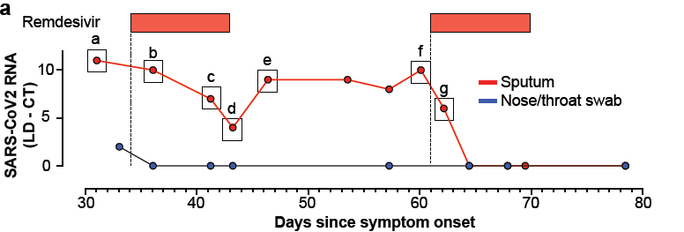
Virological response

Slide 15
Persistent COVID-19 pneumonitis in a patient with XLA
Slowly progressive disease
Persistent pneumonitis and SARS-CoV-2 viral shedding in sputum
No requirement for mechanical ventilation or multi-organ involvement
Dramatic clinical and virological response to remdesivir
No evidence of acquired drug resistance

Slide 16
Conclusions
Immune pathology in patients recruited to RCTs may have masked virological efficacy.
The lack of immunopathology in this patient suggest a causal role for antibodies.
Therefore antibodies are necessary for protection against COVID-19 but can also contribute to pathology.
The stable baseline afforded us the opportunity to asses the patient’s response to remdesivir over two independent drug challenges.
Remdesivir is a potent antiviral agent for treating SARS-CoV-2 in vivo.
Maximise utility by treating early in patients at risk, or combining.

Slide 17
Toxicity of targeting the IL-6R

Slide 18
Clinical Case
29 year old female
Born post-term, non-consanguineous parents, BW 2.8kg
Admitted within 1 month with neonatal mastitis
Within 1st year multiple infections
  Impetiginised varicella
  Right and left lower lobe pneumonias
  Painless lymphadenopathy
Normal growth, above 50th centile
(Spencer et al., 2019, J. Exp. Med.)

Slide 19
Age 5 – referred to specialist Paediatric services
  H. influenza pneumonia associated with RLL collapse
  Non-tender cervical and inguinal lymphadenopathy
  Lymph node biopsy – reactive changes, excess eosinophils, S. aureus cultured
No improvement in symptoms despite antibiotic prophylaxis
Putative diagnosis of hyper IgE syndrome – NIH HIES score 45
Recurrent sinopulmonary infections - pneumonia complicated by empyema, cultures positive for S. aureus
Chronic otitis externa
Recurrent cellulitis

Slide 20
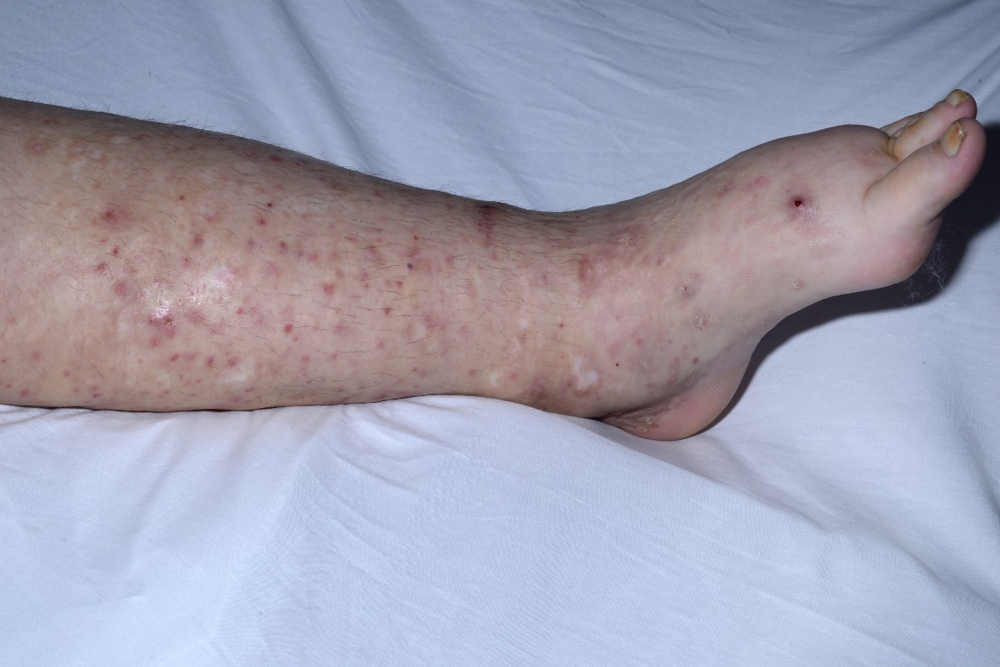
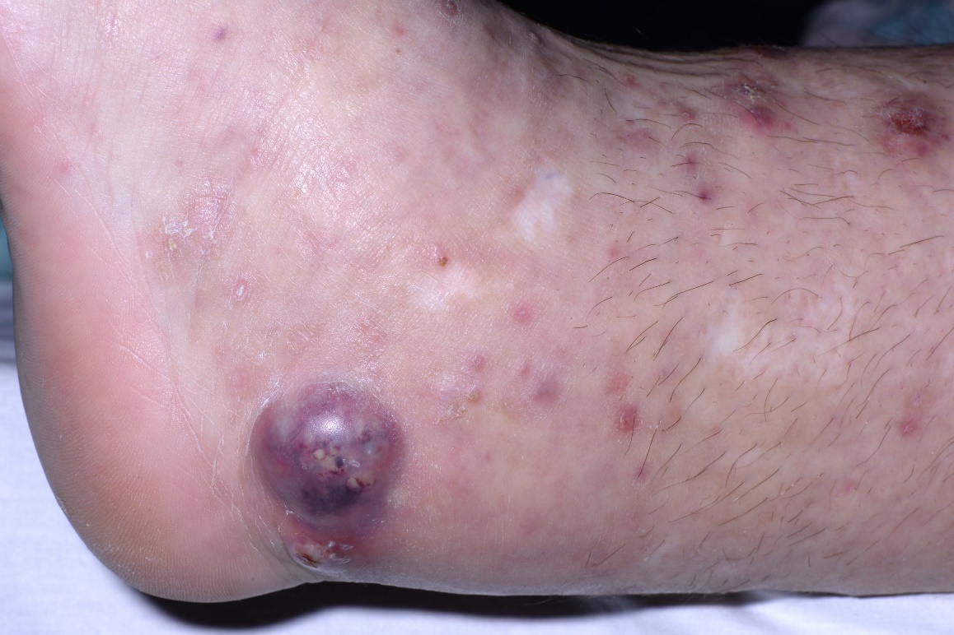
Skin lesions
  Spots or nodules
  Associated with dermatitis and intense pruritus
  Lacking erythema
  Routine growth of S. aureus on cultures
Noted to lack a normal inflammatory response with episodes of infection

Slide 21
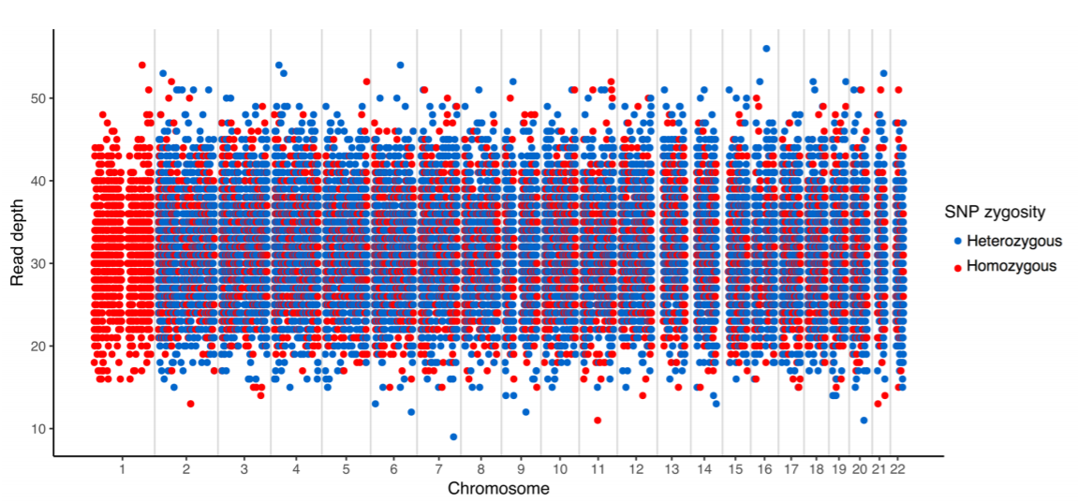
Whole Genome Sequencing
Exon 4 single bp frameshift del --> premature stop codon in IL6R gene
Patient
Mother
Father
Fig 2a

Slide 22
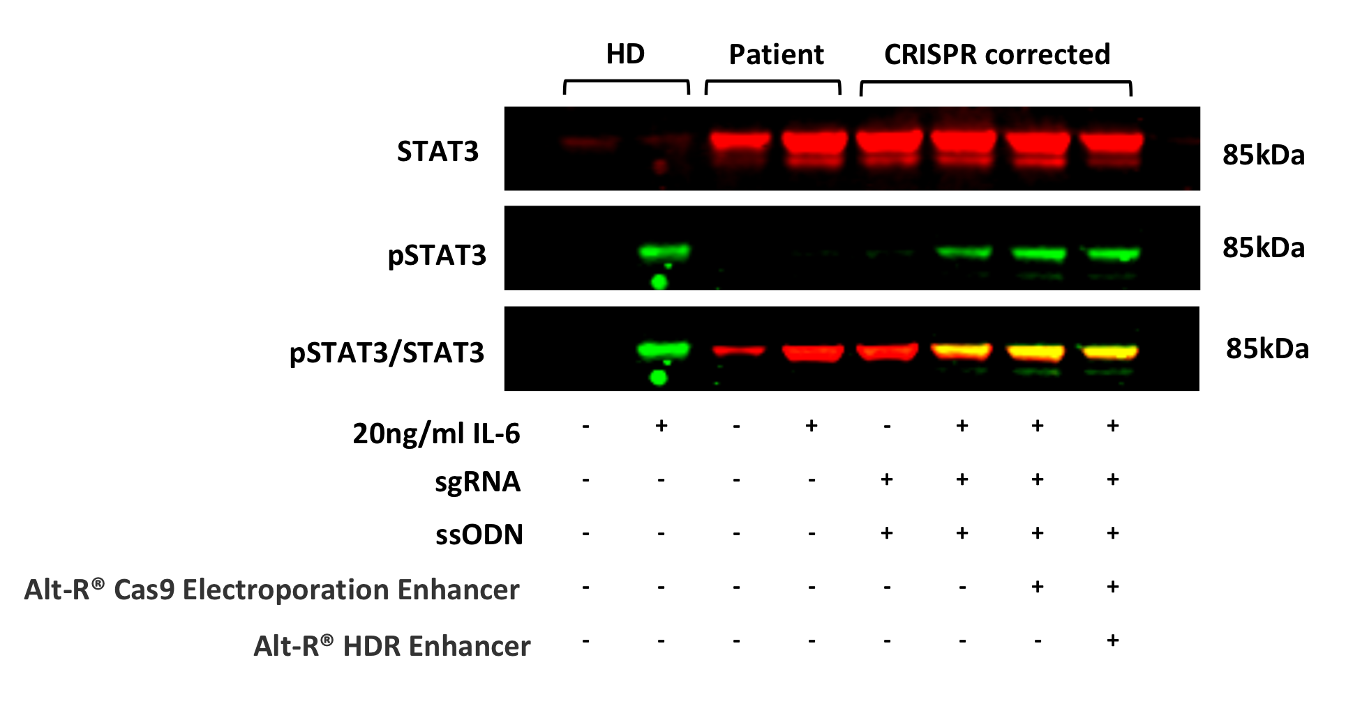
CRISPR correction
CRISPR Corrected
Uncorrected

Slide 23
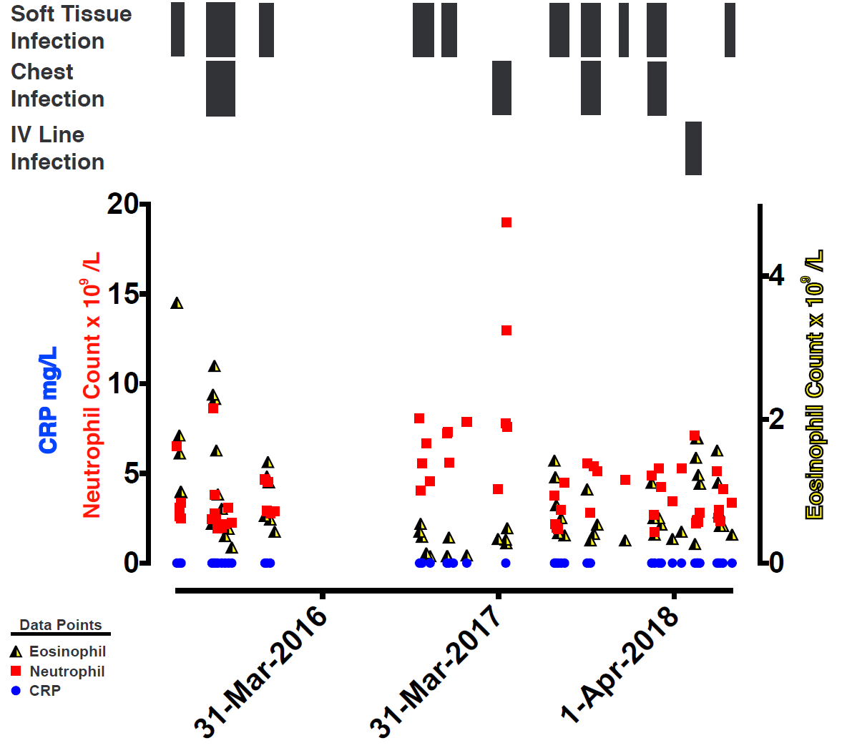

Slide 25
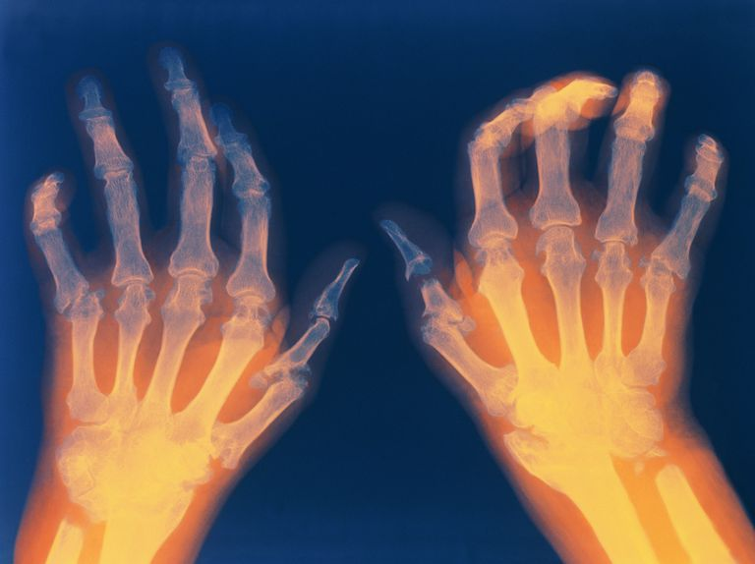
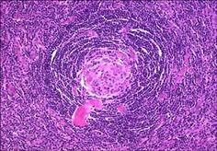
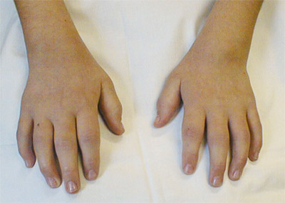
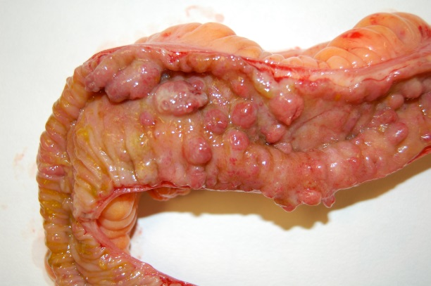
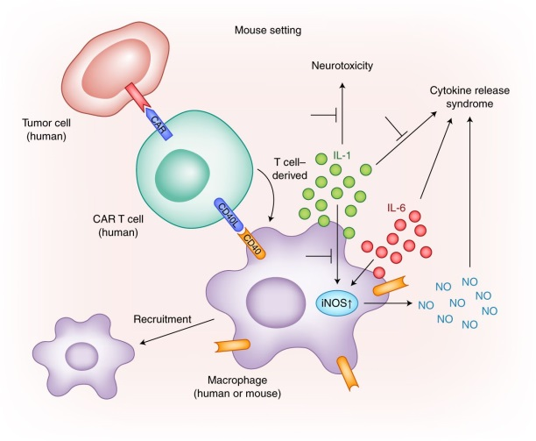
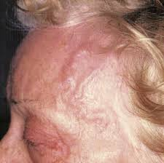
Role of IL-6
IL-6
Rheumatoid arthritis
Inflammatory bowel disease
Castleman’s Disease
Juvenile Idiopathic arthritis
Giant cell arteritis
Cytokine release syndrome

Slide 26
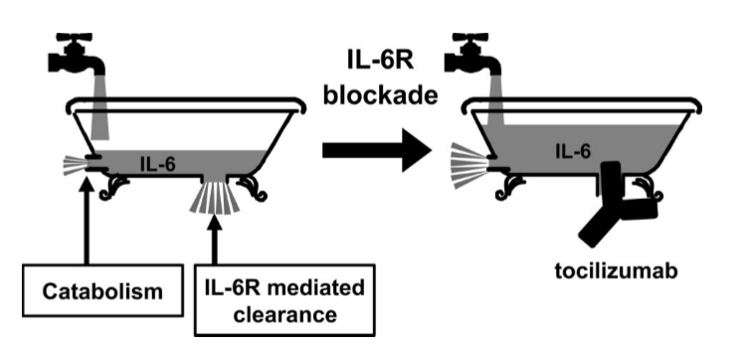
CRP as a marker of anti-IL-6 blockade
Humanized anti-IL-6 receptor monoclonal antibody (Ab) of the IgG1 class
Blocks all IL-6-mediated signals by inhibiting IL-6 binding to trans-membrane and soluble IL- 6R
Nishimoto et al., Blood, (2008), 112(10)
Notes:
Need to add reference

Slide 27
Conclusions and Questions
Susceptibility to bacterial infections is a consequence of successful IL-6 blockade
This case provides definitive evidence that CRP (within the normal range) is dependent on IL-6 signalling
A detectable CRP in a tocilizumab-treated patient indicates a failure of IL-6 blockade
How do we detect bacterial infections in ITU patients treated with IL-6 blockade?
Notes:
This case defines a new disease – human IL-6R deficiency
Impairment of IL-6 signalling is responsible for the Th2 phenotype and atopy seen in these patients
Demonstrates susceptibility to bacterial infection

Slide 28






Acknowledgements
Clinical Academic Training Office
NIHR
SARAH SPENCER
University of Cambridge, Dept of Medicine
Ken Smith
Hana Lango Allen
Meltem Gurel
Daniel Greene
Will Rae
Katarzyna Kania
Emily Staples
Annika Pecchia-Bekkum
William Worrall
Jonathan Stephens
Matthew Brown
Salih Tuna
Ernest Turro
Simon Tavaré
Duncan Jodrell
NIHR BioResource
Sheffield Teaching Hospitals NHS Trust
William Egner
Ruth Sabroe
Melanie York
Fiona Shackley
Diarmuid Kerrin
Ravishanker Sargur
Alison Condliffe
NIH NIAID, Bethesda
Josh Milner
Chi A Ma
Yuan Zhang
Guanping Sun
Sergio Rosenzweig
Hye Sun Kuehn
CeMM, Vienna
Kaan Boztug
Sevgi Kostel Bal
Tala Shahin
Rico Chandra Ardy
Marini Thian

Slide 29
University of Cambridge
Luke Meredith
Stuart Bloor
Anna Smielewska
Devan Vaghela
Lourdes Ceron-Gutierrez
Anna Yankoleva
Tiffeney Mann
Laura Bergamaschi
Lorinda Turner
Frederica Mescia
Rainer Doffinger
Ken Smith
John Bradley
Willem Ouwehand
Nick Screaton
Paul Lyons
Ian Wilkinson
Ian Goodfellow
Paul Lehner
Bart’s Health NHS Trust
Matthew Buckland
Sofia Grigoriadou
Caomhe Nicfhogartaigh
King’s College Hospital
James Galloway
Jimstan Periselneris
University of Birmingham
Nick Loman
Joanne Stockton
Josh Quick
University of Oxford
Nicholas Provine
Ane Ogbe
Carl-Philipp Hackstein
Hossain Delowar Akther
Vinicius Adriano Vieira
Dave Roberts (NHS BT)
Lise Estcourt (NHS BT)
Heli Harvala Simmonds (NHS BT)
Paul Klenerman
University of Cardiff
Paul Morgan
Wioletta Zelek
Supported by the
MRC-Toxicology Unit COVID collaboration
NIHR Bioresource/ CITIID COVID collaboration
NIHR Biomedical Research Centre, Cambridge
NIHR Biomedical Research Centre, Oxford
Oxford Immunology Network COVID-19 Response T cell Consortium

