Slide 1
How do clinical neuroscientists think the brain works (or doesn’t work)?
Paul M. Matthews, OBE, MD, Dphil, FMedSci
Edmond and Lily Safra Chair, Professor and Head, Division of Brain Sciences,
Imperial College

Slide 2
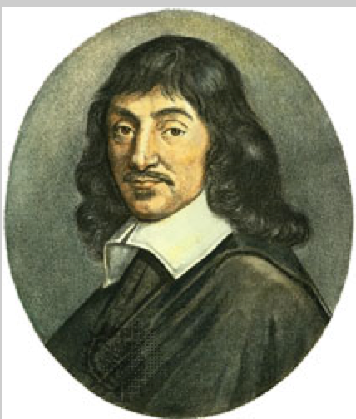
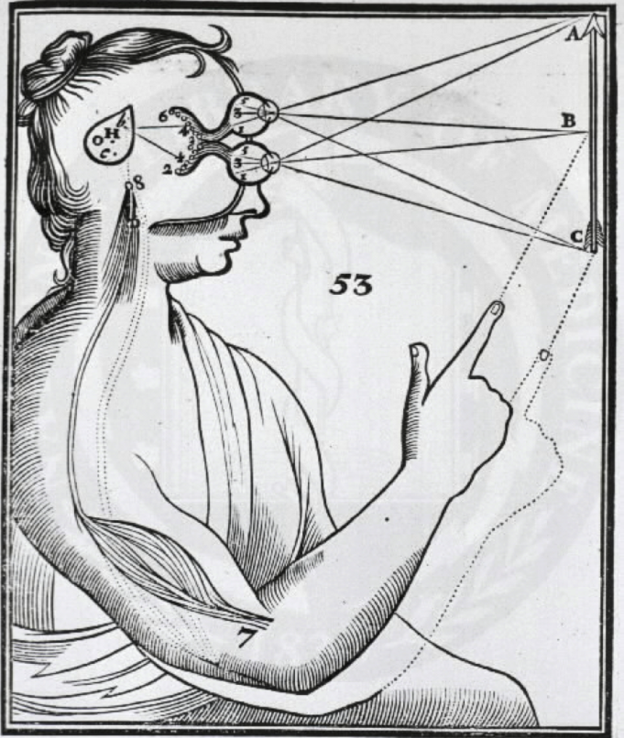
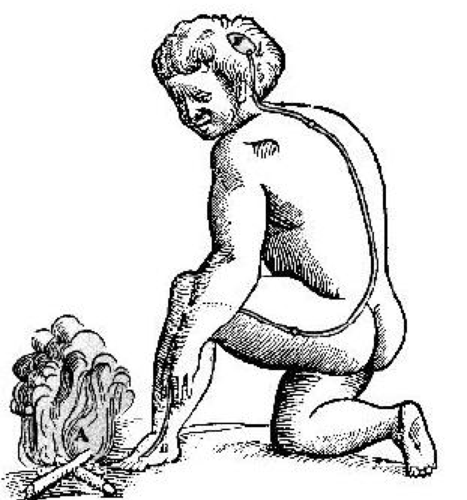
Descartes: the first cognitive neuroscientist?

Slide 3
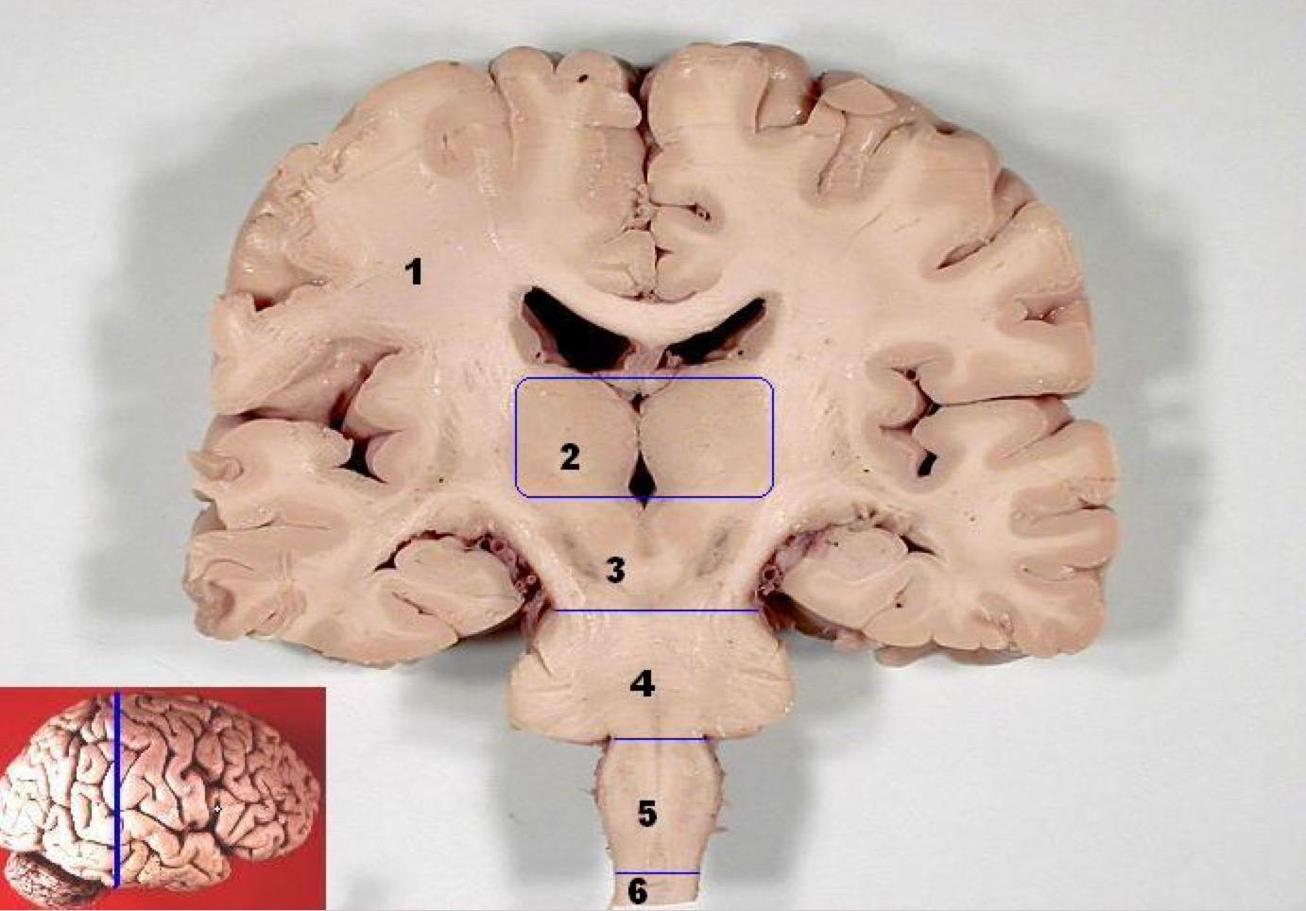
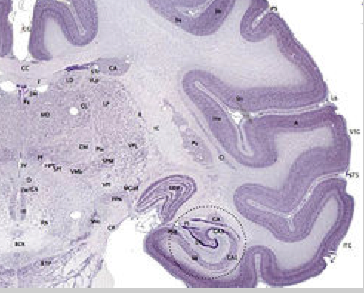
Gross morphology of the brain
Human brain
Macaque brain

Slide 4
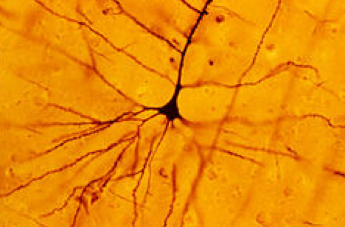
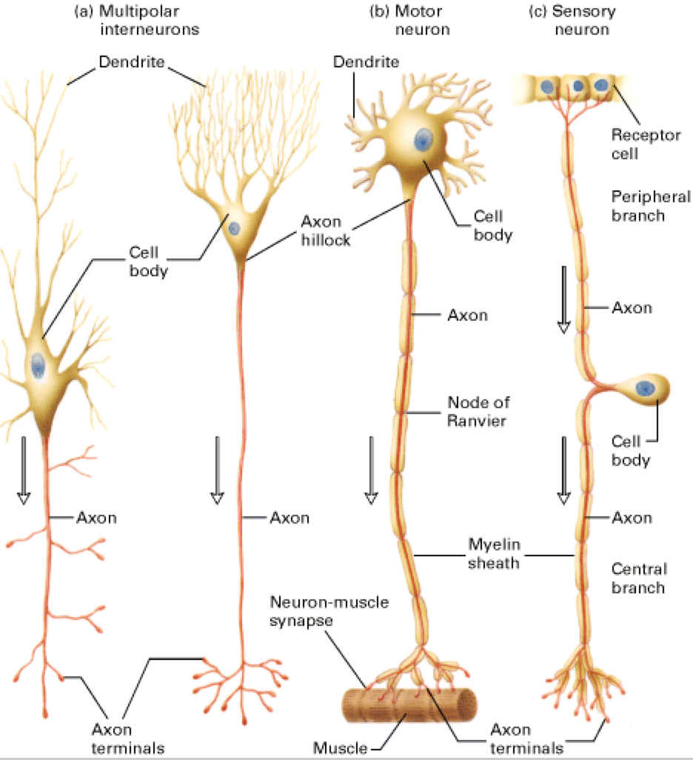
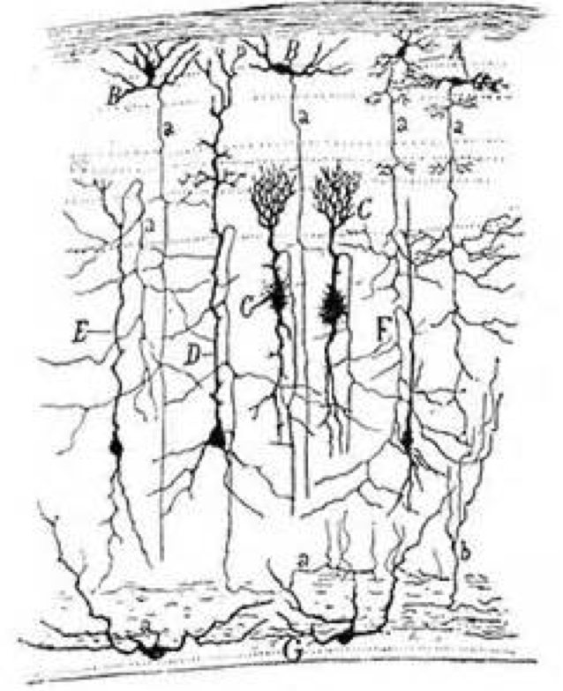
Neurons: rapid information integration and transmission

